Slide 1
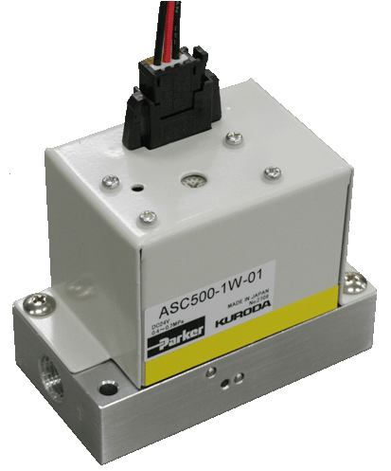
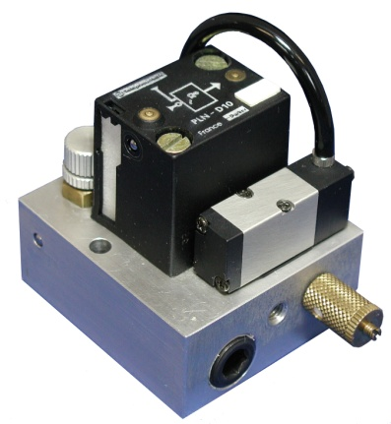
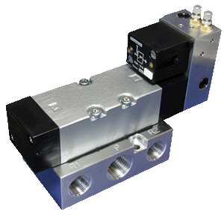
Air Saving Unit contributes to product quality improvements and sustainability programs.
NEEA Products Council Meeting
Air Saver Unit

Slide 2
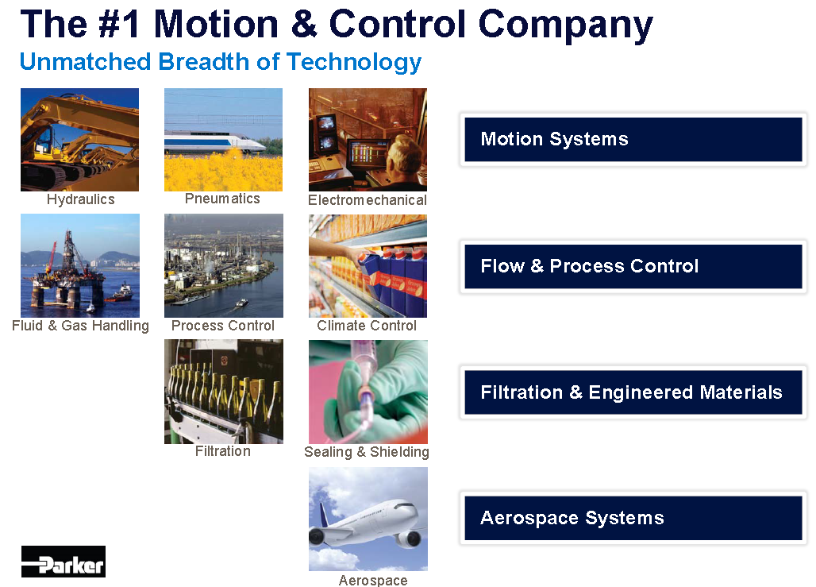
Who is Parker Hannifin Corporation?

Slide 3


Slide 4
Agenda
Parker / NEEA Products Council Meeting
Introduction to Air Saver
Value Proposition of Air Saver
Technical Data
Application Examples & Other Parker Energy Saving Products
Closing Comments Questions

Slide 5
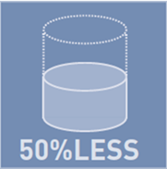
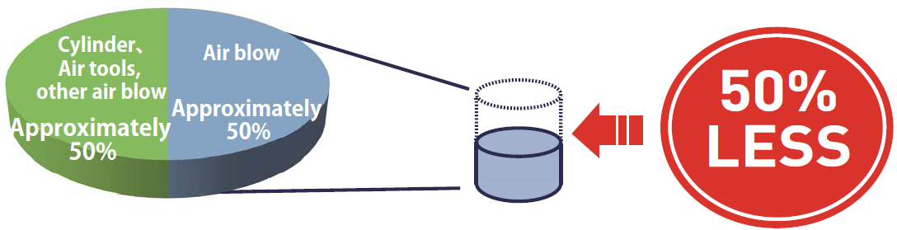
What is the Parker Air Saver?
Air Saver Unit reduces of air consumption by up to 50%
in air blow and improves blow efficiency.
Typical air consumption in plant
Various benefits are expected by using an Air Saver Unit

Slide 6

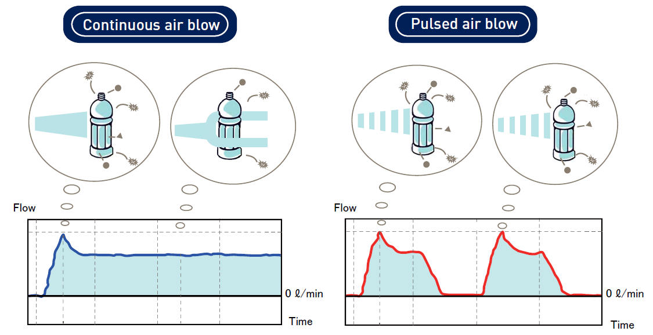
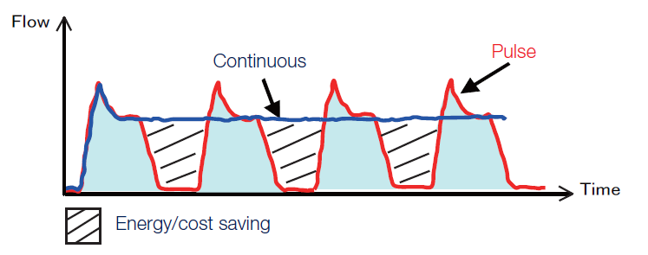
Air Saver Unit
How does it work
Converts continuous air flow into pulse blow
  Reduces consumption of compressed air
  Reduces CO2 emission associated with production of compressed air
  Improved the impulse of air blow resulting in higher efficiency

Slide 7
Agenda
Introduction to Air Saver
Value Proposition of Air Saver
Technical Data
Application Examples
Closing Comments Questions

Slide 8

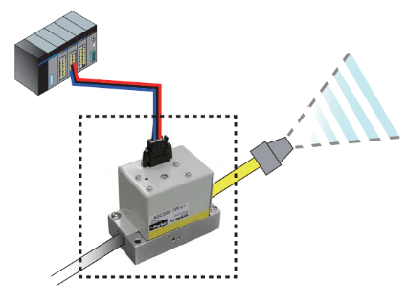
Air Saver Unit
Value proposition
Energy Savings
Improved end use effectiveness
Short payback time
Easy installation into existing pneumatic systems
Environmental objectives
  Reduces CO2 emission associated with production of compressed air
  Reduced electricity consumption
  Noise (dB) Reduction (Federal Mogul Test Report)
Notes:
High flow applications,

Slide 9
Value Proposition of Air Saver Unit
1) Energy saving in plant power consumption
Total Power consumption
Economy in Power consumption by Air Saver
Around 5% reduction of total power
consumption in the one factory
Power consumption of compressor ➔ Around 20% of total consumption in the factory
Air consumption of Air blow ➔ Around 50% of compressor air consumption
Reduction of air consumption by using Air Saver is around 50%
➔Around 5% reduction of total power consumption in the factory
Notes:
This is assuming there is an Air Saver on every blow off application

Slide 10
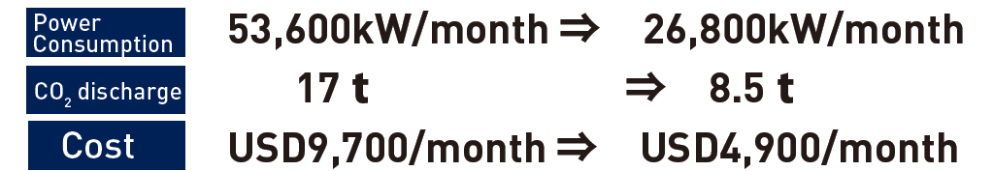
Value Proposition of Air Saver Unit
1) Energy saving in plant power consumption
Customer savings example (100 units installed in plant. 8 hrs/day, 20 days/mo)
Without Air Savers
With Air Savers
53,600 kWh/month 26,800 kWh/month 17 t 8.5 t
USD 9,700/month USD 4,900/month
Total Cost reduction $57,600
Reduction / unit $ 576
Notes: Based on an average industrial cost
of electricity = $ 0.10/ kWh

Slide 11
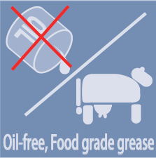
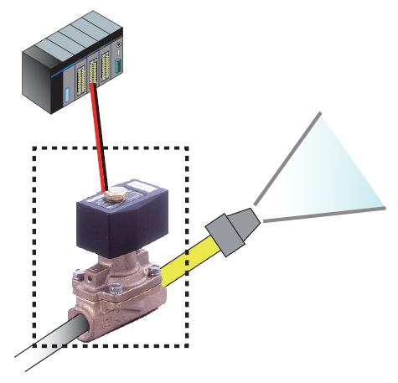

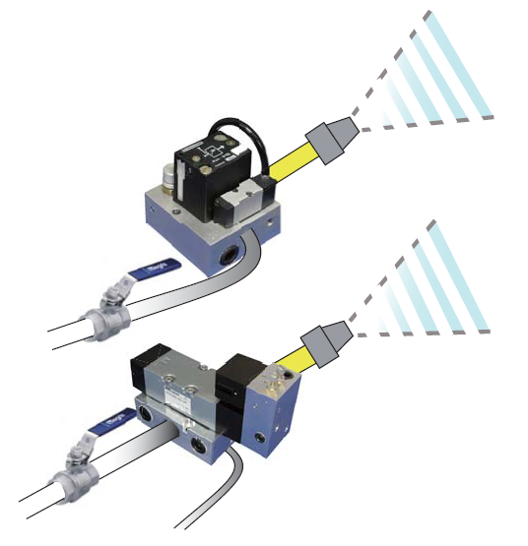
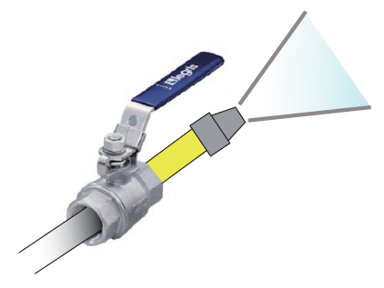
Value Proposition of Air Saver Unit
2) Easy to Install
Before Air Saver
After Air Saver
In case of using the solenoid valve to control air blow, replace valve with Air Saver without additional construction or program change
ASC500
(Solenoid valve type)
In case of manual valve, install Air Saver after current valve without additional construction or program change
ASV200 &
ASV5000 shown
(Pneumatic control type)

Slide 12
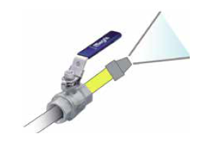
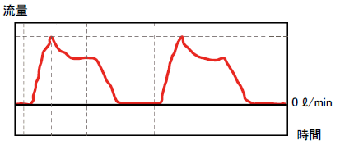
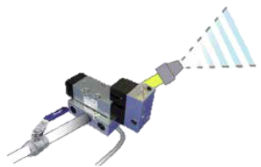
Pneumatic pilot operated (ASV200, 2000, 5000, 13000, 15000)
Value Proposition of Air Saver Unit
3) Easy to Install & Adjust
On time
On time
Off time
Adjust needle
On time
Adjust needle
Off time
Adjustment Needle - On time/ Off time
Adjustable pulse frequency & duty cycle
speed by adjustment needle
Frequency must be less than 5 Hz to
operate the valve
* Refer to the instruction sheet

Slide 13
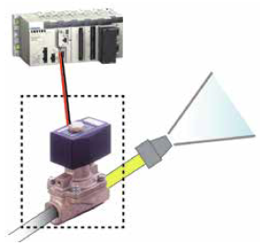
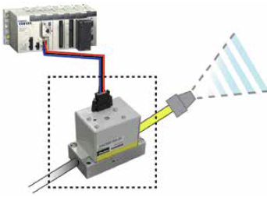
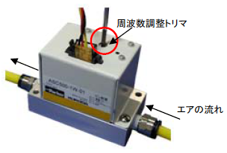
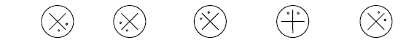
Electric operated (ASC500/ASO500)
Value Proposition of Air Saver Unit
4) Easy to Install & Adjust
On time
On time
Adjustment screw
Off time
Adjustment screw - Frequency
Air direction
Adjustable pulse frequency by adjustment screw
Frequency is set around 2 ~ 22 Hz
Duty cycle is fixed 1:1
* Refer to the instruction sheet
Frequency from the position of the screw
2Hz (min) 3Hz 6Hz 12Hz 22Hz (max)

Slide 14
Agenda
Introduction to Air Saver
Value Proposition of Air Saver
Technical Data
Application Examples
Closing Comments Questions

Slide 15

Air Saver Unit
Technical data
Complete series (flow size 5 cfm – 530 cfm)
NPT & BSPP threads (port connection from M5 to 1 ¼”)
Pneumatic pilot operated (ASV200/2000/5000/13000/15000)
Electric operated (ASC500/ASO500)
Adjustable pulse frequency & duty cycle (optimized performance)
Long life cycle (Seal technology – metal to metal)
Silicon free version for paint applications (coming soon)
Adjustment screw
Air direction

Slide 16
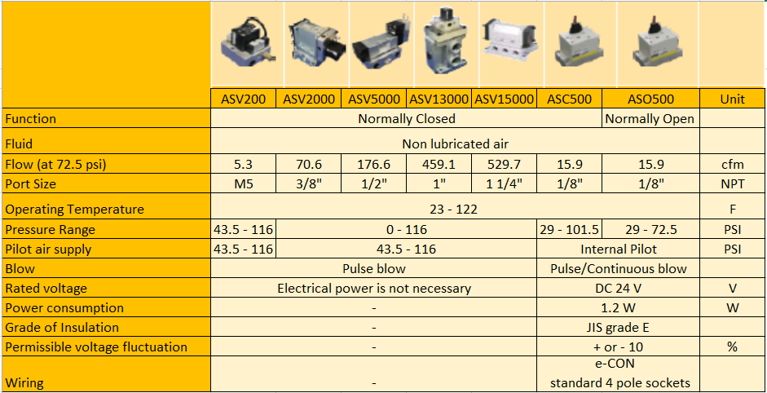
Air Saver Unit
Technical Data – Product portfolio

Slide 17
Agenda
Introduction to Air Saver
Value Proposition of Air Saver
Technical Data
Application Examples
Closing Comments Questions

Slide 18
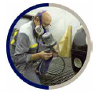
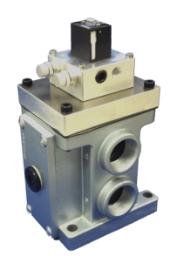
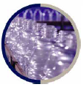
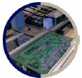
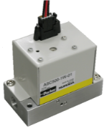
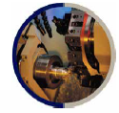
Air Saver Unit
Applications to target
Machine Tooling (Die-cast, cutting, feeding)
  Cleaning of parts for painting (silicon free grease)
  Cleaning of machined parts
  Feeding parts
  Ionizer for resin part
Packaging and Conveying
  Cleaning and Distribution of PET bottling
Printing Industry
  Paper feeding/handling machinery

Slide 19
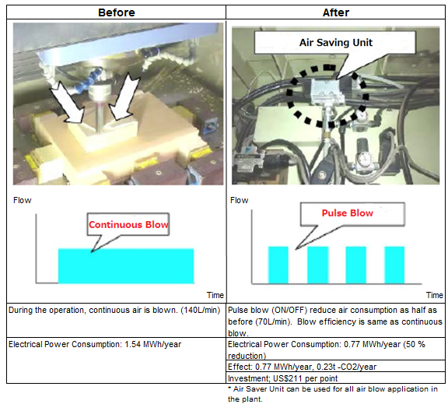
Energy Saving Engineering Report (2)
Implementation of Air Saver Unit
Install Air Saver Unit to the production line in the plant and exchange from continuous air blow to pulse air blow. It compensated about 50% air reduction in plant.
Notes:
ここでは、パルスエアーブローの採用となっていますが、その内容は“エアセービングユニット”そのものです。
レポートには“エアセービングユニット”の写真まで掲載されています。このように、業界全体から注目を浴びています。
（ASV5000の写真）
※ 6ページに戻って
170社のアンケート結果では、およそ5%の企業がエアセービングユニットの導入を完了させたと回答しています。
一部済と今後実施を合わせて70%の回答者がエアセービングユニットの導入を検討していることが分かります。
一方、残念なことに、実施不可と回答された割合も30%あることが分かります。
ではなぜ、“エアセービングユニット”が導入できないのか？

Slide 20
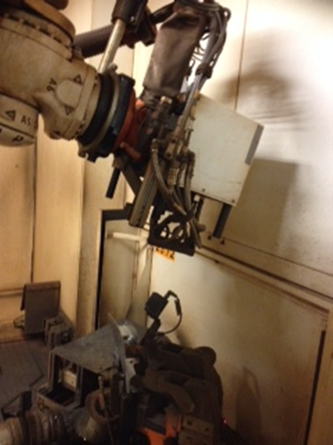
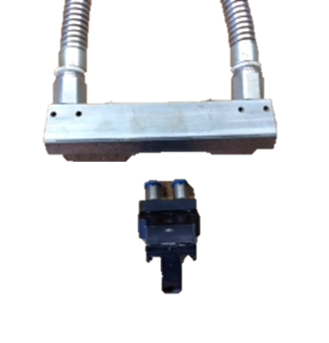
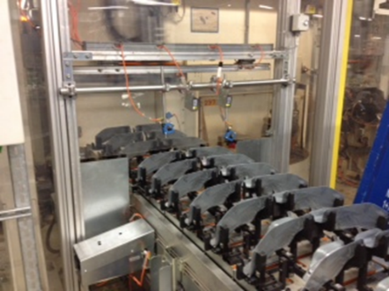
Significant Opportunity
Car Manufacturer
Problem
For Laser weld application customer is looking for air consumption improvement contributing to company strategy to reduce energy cost and CO2 emission with 25% by 2018
Solution
Success Factors Customer Value
ASV2000 contributes to reduce energy cost and CO2 emission for high flow weld laser application to keep weld head clean and protect against weld particles and dust
Easy installation
PSC customer relation
Improvement of impulse of blow
Energy savings
CO2 reduction
Potential energy saving of >$200K/yr
Featured Products:
Market:
Competitor:
Distributor:
Parker Potential:
ASV2000
Automotive InPlant
Direct
k$50 / project
Lead Sales Contact
Sales Company Germany
Notes:
Volkswagen AG, Wolfsburg: Application to protection the laser weld head against weld particles.

Slide 21
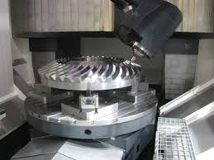
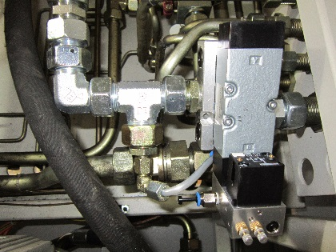
Significant Opportunity
Car manufacturer
Problem
For production of gear wheel operation, customer is looking for air consumption improvement contributing to strategy of energy cost reduction with associated CO2 emission
Solution
Success Factors Customer Value
ASV5000 contributes to reduce energy cost and CO2 emission for cleaning operation of machined parts, removal of swarf and cooling liquids
Easy installation
PSC customer relation
Improvement of impulse of blow
Energy savings
CO2 reduction
Improvement of blow process
Featured Products:
Market:
Competitor:
Distributor:
Parker Potential:
ASV5000
Automotive In Plant
Direct
k$20 / project
Lead Sales Contact
Sales Company Germany
Notes:
Opel Removal of swarf and cooling liquids during machining process.

Slide 22
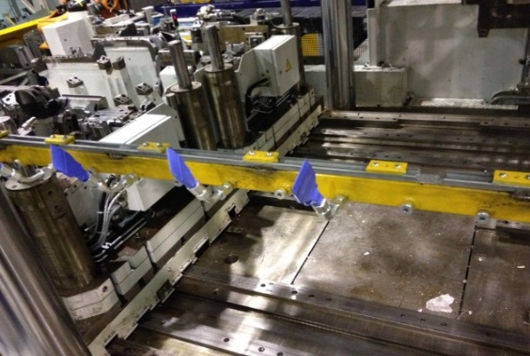


Significant Opportunity
Car Manufacturer
Problem
For production of machined parts for car manufacturer, customer is looking for air consumption improvement contributing to strategy of energy cost reduction with associated CO2 emission
Solution
Success Factors Customer Value
ASV2000 contributes to reduce energy cost and CO2 emission for cleaning operation of machined parts, removal of swarf and cooling liquids
Easy installation
PSC customer relation
Improvement of impulse of blow
Energy savings
CO2 reduction
Potential energy saving of >$25K/yr
Featured Products:
Market:
Competitor:
Distributor:
Parker Potential:
ASV2000
Automotive In Plant
Direct
k$10 / project
Lead Sales Contact
Sales Company Germany
Notes:
BMW , swarf and dust removal

Slide 23
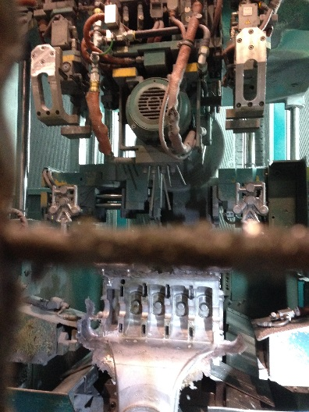
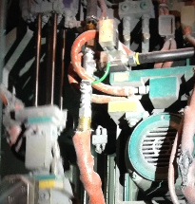

Significant Opportunity
Car manufacturer
Problem
Cleaning (remove of swarf) of casted parts for car manufacturer, customer is looking for air consumption improvement to reduce energy cost with and CO2 emission
Solution
Success Factors Customer Value
ASV5000/13000 contributes to reduce energy cost and CO2 emission for cleaning operation of machined parts, removal of swarf and cooling liquids
Easy installation
PSC customer relation
Improvement of impulse of blow
Energy savings
CO2 reduction
Potential energy saving of >$25K/yr
Featured Products:
Market:
Competitor:
Distributor:
Parker Potential:
ASV5000/13000
Automotive In Plant
Direct
k$15 / project
Lead Sales Contact
Sales Company Germany
Notes:
BMW Landshut – Removal of swarfs during sawing operation on casted engine parts

Slide 24
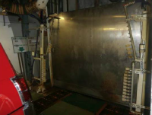
Significant Opportunity
Car manufacturer
Problem
For final test and clean of passenger car body, customer is looking for air consumption improvement to reduce energy cost with associated CO2 emission
Solution
Success Factors Customer Value
ASV13000 contributes to reduce energy cost and CO2 emission for cleaning operation of car final water leak test before leaving plant
Easy installation
PSC customer relation
Improvement of impulse of blow
Energy savings
CO2 reduction
Improvement of air blow process
Featured Products:
Market:
Competitor:
Distributor:
Parker Potential:
ASV13000
Automotive In Plant
Direct
k$25 / project
Lead Sales Contact
Sales Company Japan
Notes:
Before car body goes into paint shop, needs to be cleaned from dust

Slide 25
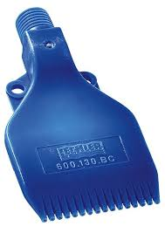
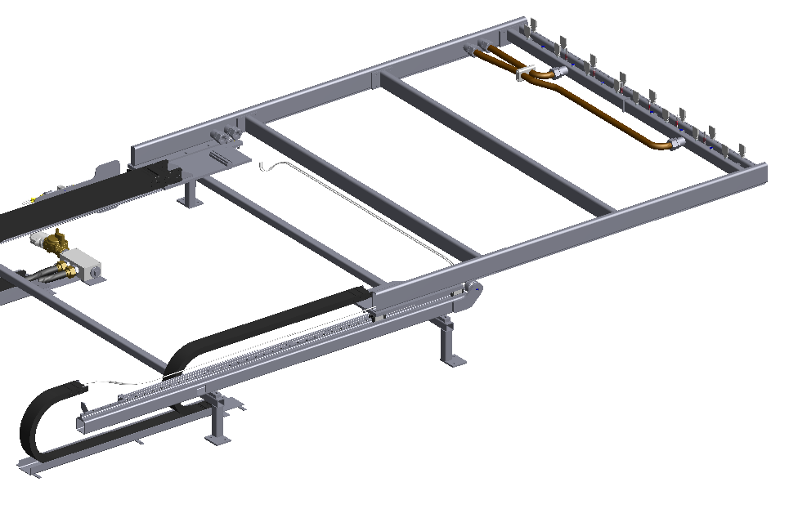
Significant Opportunity
Car manufacturer
Problem
To clean sand casted parts, air blow removes all sand particles from parts. Customer is looking for air consumption reduction to reduce energy cost with associated CO2 emission
Solution
Success Factors Customer Value
Depending on available space in equipment, customer is looking for ASV13000 (2 unit) or ASV5000 (3 units). ASU is easy to install in equipment.
Easy installation
PSC customer relation
Improvement of impulse of blow
Energy savings
CO2 reduction
Improvement of air blow process
Featured Products:
Market:
Competitor:
Distributor:
Parker Potential:
ASV5000/13000
Automotive In Plant
Direct
k$10 / project
Lead Sales Contact
Sales Company Germany
Notes:
Company Kurz, machine builder for BMW for deburring of casted/molded parts.

Slide 26
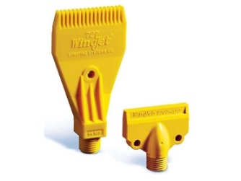
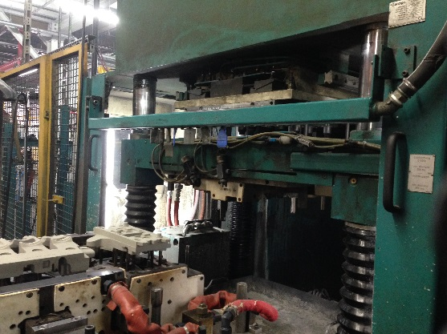

Significant Opportunity
Car manufacturer
Problem
To clean sand casted parts, air blow removes all sand particles from parts. Customer is looking for air consumption reduction to reduce energy cost with associated CO2 emission
Solution
Success Factors Customer Value
ASV5000 or ASV13000 contributes to reduce energy cost and CO2 emission for cleaning operation of sand casted parts
Easy installation
PSC customer relation
Improvement of impulse of blow
Energy savings
CO2 reduction
Improvement of air blow process
Featured Products:
Market:
Competitor:
Distributor:
Parker Potential:
ASV5000/13000
Automotive In Plant
Direct
k$10 / project
Lead Sales Contact
Sales Company Germany
Notes:
BMW Landshut, machine to clean sand casted parts for engine production.

Slide 27
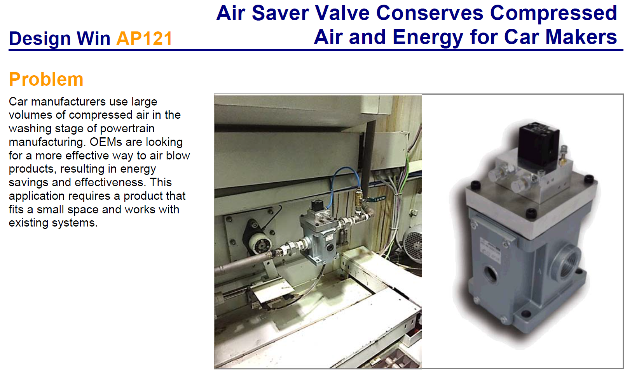
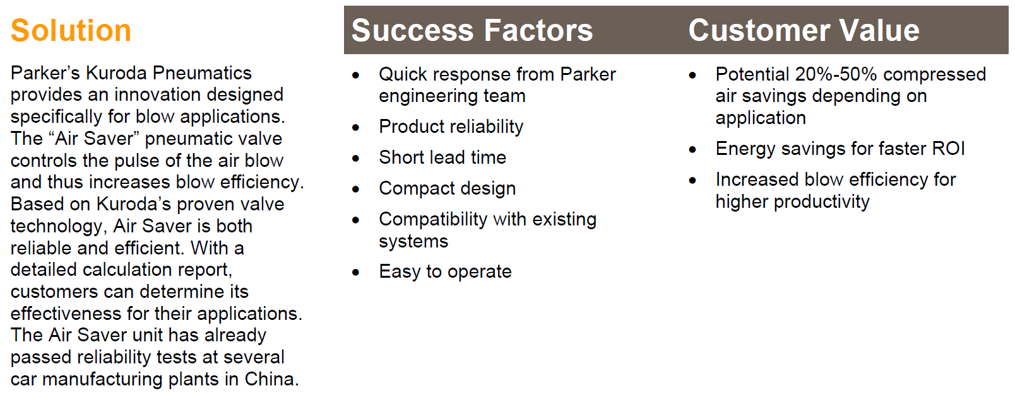
Significant Opportunity
Car manufacturer
Notes:
BMW Landshut – Removal of swarfs during sawing operation on casted engine parts

Slide 28
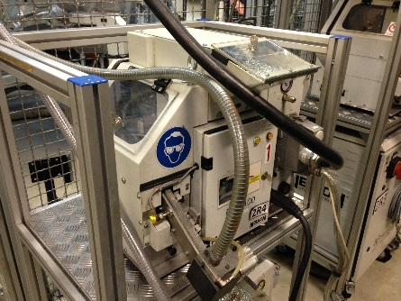
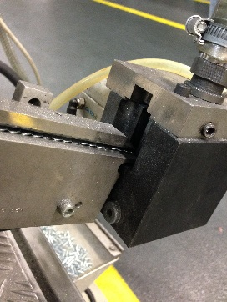
Significant Opportunity
Car manufacturer
Problem
For bolt feeder equipment, air blow is used to distribute bolts to bottom plate of car. Customer is looking for air consumption reduction to reduce energy cost with associated CO2 emission
Solution
Success Factors Customer Value
Depending on available space in equipment, customer is looking to integrate Air saver Unit to reduce compressed air consumption for bolt feed handing equipment
Easy installation
PSC customer relation
Improvement of impulse of blow
Energy savings
CO2 reduction
Improvement of air blow process
Featured Products:
Market:
Competitor:
Distributor:
Parker Potential:
ASV2000/5000
Automotive In Plant
Direct
k$32 / project
Lead Sales Contact
Sales Company Germany
Notes:
BMW Munchen, bolt feeding equipment (Nelson) to feed weld bolts to car bottom plate.

Slide 29
Agenda
Introduction to Air Saver
Value Proposition of Air Saver
Technical Data
Application Examples
Closing Comments Questions

Slide 30
Thank you
Air Saver Unit
Together we can create a cleaner world for the future. Today
30

Slide 31


Slide 32
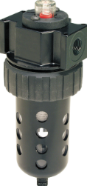
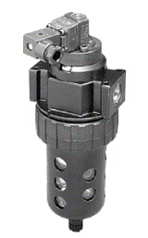
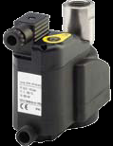
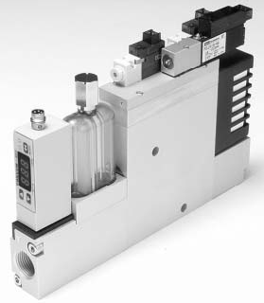

Other Parker Energy Saving Products & Tools
Pressure Differential Sensors
Monitor pressure drop on filters.
Provide electrical signals or visual indicators when pressure drop is high and filter elements need replaced.
Can assist you in lowering compressed air costs by reducing pressure drops.
Air Economizing Vacuum Generators
Built-in sensors only apply air pressure when vacuum is needed.
Sensor turns generator on when vacuum drops to a preset level.
Saves a lot of compressed air costs.
Reverse Flow Regulators
Most actuators only need work force in one direction.
Installed between valve and actuator.
Reduces pressure on the return stroke of an actuator where work force is not needed.
Saves a lot of compressed air costs.
Zero Loss Air Drains
Many Compressors and Air Tanks use Timer Drains to purge water and moisture from the tanks.
Timer Drains waste compressed air because they blow too long, and blow when no water is present.
Zero Loss Drains use floats to actuate the drain to open and blow out moisture and shut off once moisture is gone., saving compressed air costs.

Slide 33


Other Parker Energy Saving Products & Tools
Wear Compensated Seals
Air valve spools that have wear compensation
Air pressure forces the seals out to the valve bore.
Very little air leakage across these spools through out it’s life.
Especially better than lapped spool valves.
Low Power Solenoids
Typical Class 8 22mm Coil Wattage 5.4W
Parker 15mm Coil Wattage 1.2W
Save 4.2W while doing work
Pneumatic Sizing Tools
Air Cost, Flow, and Product Sizing Calculators
Conversion tools (e.g. Pressure BAR to PSI)
Available on website www.parkerpdncalc.com, downloadable for cell phones and I Pads from Apple App Store.
Straight Fittings, Pre-sealed
Factory applied thread sealant perform better than operator applied sealant.
  Where ever possible, use straight fittings in place of 45 or 90 degree elbow fittings to minimize pressure drop and save on compressed air costs.

Slide 34

Federal Mogul – Air Saver (dB) Flow Test Report
Kevin Swayze @ Federal Mogul

Slide 35
Plant Engineering Product of the Year
Good morning,Rich McDonnell:
Thank you for entering the Plant Engineering 2016 Product of the Year awards program. We are pleased to let you know that the Parker Air Saver by Parker Hannifin has been named a Winner in the Compressed Air category. Congratulations!
Announcement: Each Product of the Year award Winner will be mentioned and linked from the print and digital editions of the April 2017 issue. They will also be posted online at www.plantengineering.com/poy on Tuesday, April 4, 2017.
Embargo: Please embargo all announcements until the Plant Engineering announcement of your achievement the morning of Tuesday, April 4, 2017. Both low- and high-resolution versions of the 2016 Product of the Year Winner logo for your promotional usage can be downloaded by visiting www.plantengineering.com/16POYWinner.
Presentation: A Gold, Silver, or Bronze trophy will be presented for each winning product at the 2017 Engineering Awards in Manufacturing dinner on Monday, April 3, 2017, at the Renaissance Chicago Downtown Hotel. We request that a representative from each company attends this event – a formal email invitation will be sent early next week.
Thanks, again! Hope to see you in April!
Sincerely,
Amanda Pelliccione
Director of Research
Events & Awards Programs
CFE Media LLC
www.CFEMedia.com
O: 860-432-4767
M: 978-302-3463
Announcement Embargo
until Tuesday, April 4, 2017

