Slide 1
NEEA Products Council Meeting Air Saving Unit Investigation
SBW Consulting
January 24, 2017

Slide 2
Agenda
Background
Preliminary Findings
Potential Regional Savings
Alternate Technologies
Next Steps

Slide 3
Background
SBW’s compressed air experience
NEEA request to investigate efficiency potential
Visit to Parker Pneumatic’s lab
Test stand measurements
ASU familiarity
Notes:
Experience – Developed the Compressed Air Management Program in conjunction with PG&E 18 years ago
- PG&E, Turlock Irrigation District, Silicon Valley Power (2 rounds) plus audits performed at pulp mills for BC Hydro
- Measurement-based system audits paid for by utility
- Recommend system improvements
- Incentive payments based on verified savings from post-installation measurements
Parker requested technology approval from NEEA toward end of 2015
Geoff got a recommendation to contact SBW for technical assistance

Slide 4
Agenda
Background
Preliminary Findings
Potential Regional Savings
Alternate Technologies
Next Steps

Slide 5
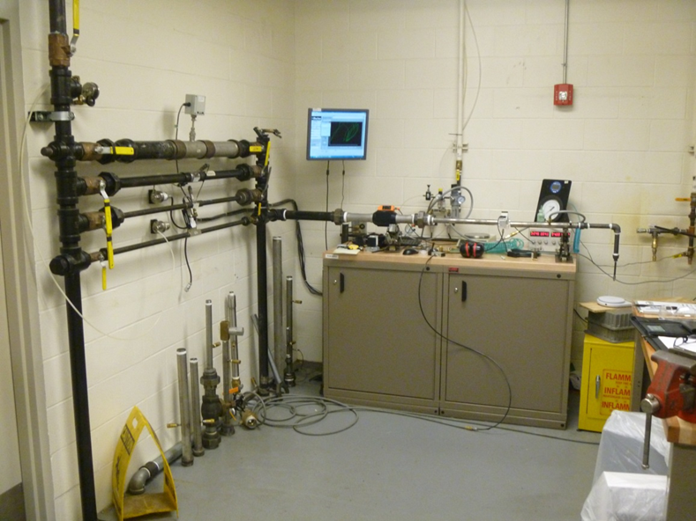
Preliminary Measurements – Test Stand
Notes:
Manifold
Meter
ASU
Display

Slide 6
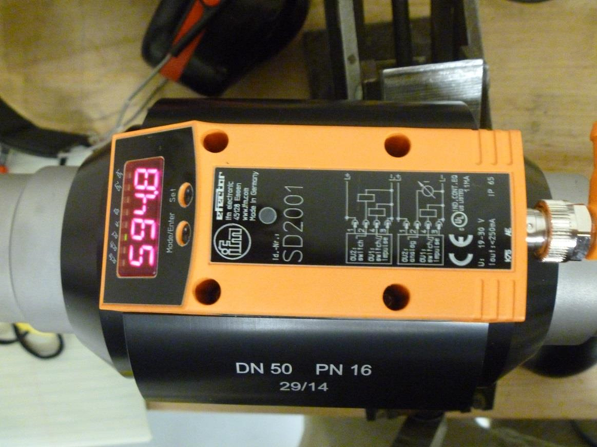
Preliminary Measurements – Flow Meter

Slide 7
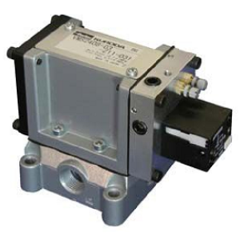
Air Saving Unit
Notes:
Point out & quickly describe “ON” & “OFF” adjustment screws

Slide 8
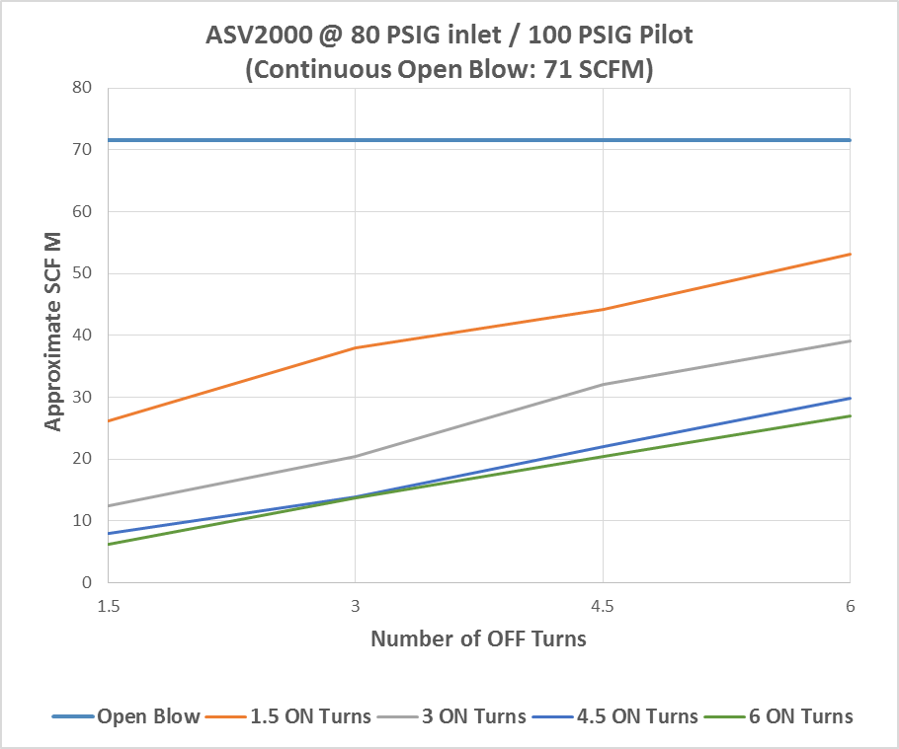
Preliminary Findings– Flow Reduction
Notes:
Each line corresponds to a constant “ON” adjustment
Each value on the x-axis corresponds to a constant “OFF” adjustment
Topmost blue line is open blow (all “ON”, no “OFF”)
Data collected by adjusting “ON” setting, then stepping through “OFF” settings
More “ON” turns reduces flow
More “OFF” turns increases flow

Slide 9
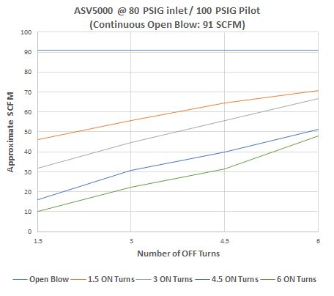
Preliminary Findings– Flow Reduction (cont.)
Notes:
Similar results for ASV5000

Slide 10
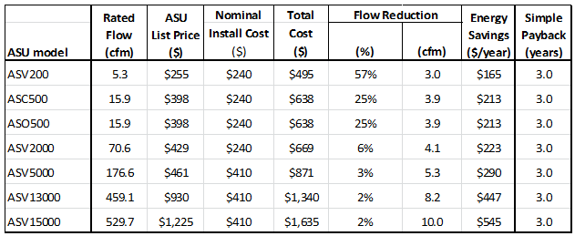
Preliminary Findings – Cost Effectiveness
Notes:
Rough calculations – ASU list prices were preliminary – may not be final
Installation costs include labor & materials
Set a target payback period of 3 years
Assumptions:
20 kW/100 cfm (screw compressor)
$0.065/kWh – avg electric cost in NW
4160 hours/year operation (2 shifts)
3-yr payback
Backed into the %flow reduction from rated cfm required of each ASU
All but the ASV200 should be able to meet the required flow reduction for 3-yr payback

Slide 11
Agenda
Background
Preliminary Findings
Potential Regional Savings
Alternate Technologies
Next Steps

Slide 12
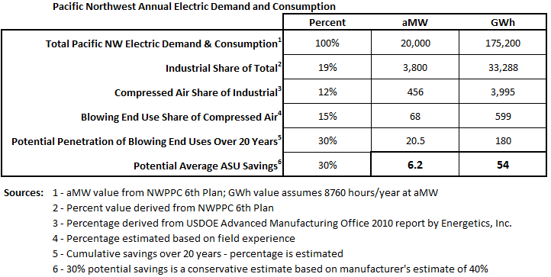
Potential Regional Savings Estimate
Notes:
Rough estimates – 1st two items probably most reliable
Last item is conservative – could easily increase by 1/3rd or more

Slide 13
Agenda
Background
Preliminary Findings
Potential Regional Savings
Alternate Technologies
Next Steps

Slide 14
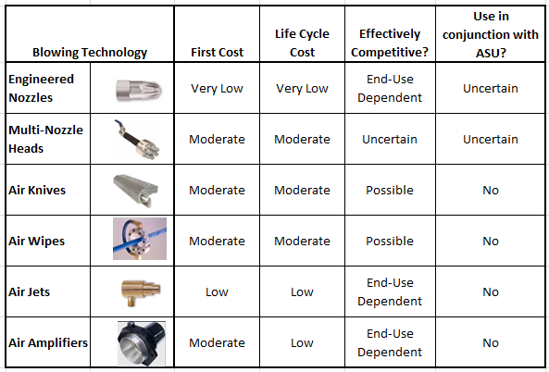
Competing Technologies
Notes:
Engineered nozzles most direct competition, especially for smaller loads – multi-nozzles essentially fall in that category but are not generally fixed in place
ASUs with multiple “fan-shaping” nozzles may compete with air knives
Air wipes may be similar to air knives in that regard, just different configuration
Air Jets could compete
Air Amplifiers
KEY POINTs: 1) Can ASUs be competitive with respect to end-use effectiveness in the various applications?; 2) Can ASUs & listed devices be effective in conjunction?

Slide 15
Agenda
Background
Preliminary Findings
Potential Regional Savings
Alternate Technologies
Next Steps

Slide 16
Next Steps: ASU Field Tests
Objectives
Measurement based analysis
Compressed air savings
Cost effectiveness
Observe end-use effectiveness
Determine customer acceptance
Process
Participant recruitment
Baseline & Efficient case measurements
Analysis & reporting with recommendations

Slide 17
Further Steps (as warranted)
Prepare Performance Specification based on flow interruption
Development of RTF Measures
Informational & Educational Outreach

