Slide 1

Commercial Building Stock Assessment: Results Webinar
May 11th, 2020
Webinar Etiquette
Use the chat dialog box (on left) to ask questions related to the presentation (content, etc.)
Use the Q&A tab below the presentation to ask technical questions, and we will assist you (audio/video issues, etc.)
Once the presentation has begun, microphones will be
auto-muted
In the event of a technical disruption (on your end), please click the link in the meeting invite again to rejoin the meeting. If, for some reason, all participants are disconnected, we will send out a NEW invite with instructions.

Slide 2
2019 Commercial Building Stock Assessment
Aaron James
Jeff Cropp
Market Intelligence Analyst, NEEA
Principal, Cadmus
May 11, 2020
Classification Level: Public

Slide 3
Agenda
General Overview of CBSA Study
Study Methods
High Level Findings
  Building Characteristics
  Space Heating and Cooling
  Water Heating
  Lighting
  Energy Use Intensities
Conclusions

Slide 4
General Overview

Slide 5
Commercial Building Stock Assessments
2003
2014
2019
2009
Conducted region-wide
Provide inputs into regional power plan and utility energy efficiency program design and planning
Establish baseline of current use
To the extent possible, observe changes in building stock over time
Developed through collaborative process with stakeholder working groups

Slide 6
2019 CBSA
Phase 1 Study (SBW Consulting)
  Sample Design
  Data Collection Fields
Phase 2 Study (Cadmus)
  Develop Sample Frame
  Implement Sample Design
  Data Collection
  Develop Case Weights
  Data Analysis
  Database and Reporting

Slide 7




Cadmus Team

Slide 8
Major Changes from 2014 to 2019 CBSA
Sample design
  Innovative virtual catalog
  Two-stage sample design
  Specific definition for sites (one or more buildings in a census block on contiguous parcels with the same property taxpayer)
  Set 1,000 square feet as minimum site floor area
  2014 sampled new construction at higher rate than other vintages

Slide 9
Major Changes from 2014 to 2019 CBSA
Building types
  Excluded universities
  Added “mixed commercial” building type
  Removed small residential care
  Excluded exterior parking garages and vacant buildings

Slide 10
Major Changes from 2014 to 2019 CBSA
Updated data collection fields
  Tablet-based data collection
  Removed or consolidated many fields
  More extensive detail on pump systems
Analysis
  Not clear whether 2014 used sites or buildings for analysis
  2019 conducted most analysis on building-level (except EUIs)
  Updated case weighting method based on two-stage sample

Slide 11
CBSA 2019 Methods

Slide 12
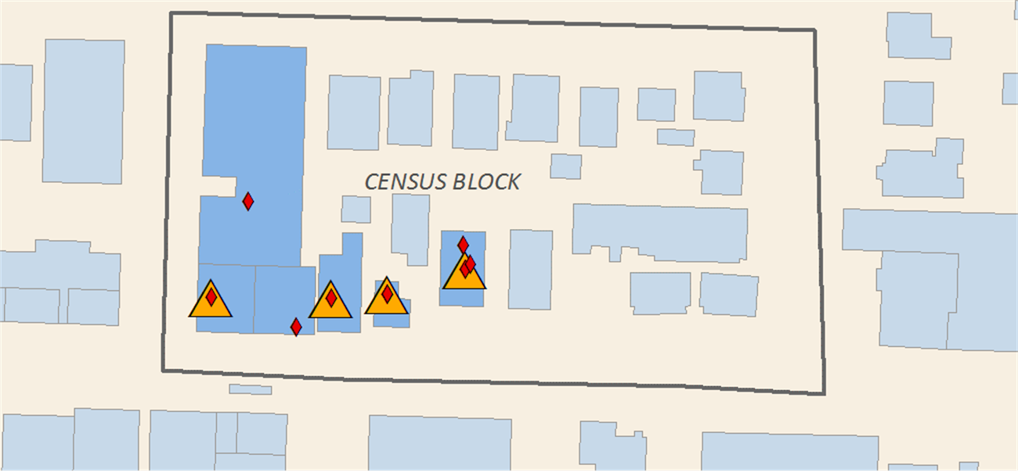

CBSA 2019 Methods: Virtual Catalog
Innovative Technique Using Geocoded Data
Combined Data from:
  Google Places (back-end data for Google Maps)
  SMR Research (parcel-level tax assessor data)
  U.S. Census Bureau geospatial and tabular datasets
Notes:
Google Places – updated business and establishment info, including sites not often reflected in tax assessor data (non-profits, hospitals, government buildings)
SMR – traditional tax assessor dataset, but included both actual and imputed floor areas in many cases
Census bureau – geospatial polygons for determining census block borders

Slide 13
CBSA 2019 Methods: Two-Stage Sample
Stage 1 Sample
  Filtered virtual catalog to remove nonapplicable sites
  Sampled 5,000 census blocks
  Stratified on size, region, density, urban/rural, IOU/POU
  Manual review of census blocks
  Resulted in ~30,000 sites
Stage 2 Sample
  Stratified by building type
  Sampled in waves
  No more than two sites per block
  Soft targets by floor area and region to ensure reasonable representation
Notes:
Stage 1 sample: stratified based on measure of size, region, utility type, urban/rural, and commercial floor area density
Top 1,500 blocks selected with certainty
Manual review through Shiny app with aerial imagery and Google searches
Verified and updated building type categories and commercial floor areas
Flagged ineligible sites, including the following:
Commercial sites smaller than 1,000 square feet
Home-based businesses
Addresses corresponding to nonexistent commercial buildings
Sites incorrectly identified as commercial
Duplicate commercial sites observed in both the SMR parcel and Google Places data not previously identified as being the same site

Slide 14
CBSA 2019 Methods: Sample Targets
Targeted Size Strata
  Small: 1,000 to 10,000 ft² (51%)
  Medium: 10,000 to 100,000 ft² (34%)
  Large: greater than 100,000 ft² (15%)
Regional strata
  Idaho/Montana: 17%
  Oregon: 27%
  Washington: 55%
Building Type | Stage 1 Sites | Sample Targets
Assembly | 20,663 | 56
Grocery | 11,162 | 68
Hospital | 922 | 45
Lodging | 5,809 | 71
Mixed Commercial | 40,157 | 83
Office | 58,612 | 116
Other | 5,745 | 21
Residential Care | 6,042 | 80*
Restaurant | 19,188 | 51
Retail/Service | 58,416 | 89
School | 8,669 | 45
Warehouse | 26,194 | 83
Total | 261,579 | 808*
Notes:
After meeting the soft target for Washington state, we stopped active recruitment efforts in western Washington but increased targeting for sites in eastern Washington, which shares a similar climate to Idaho and Montana.

Slide 15
CBSA 2019 Methods: Recruitment
Cadmus Asked Utilities, BPA, and Energy Trust to First Review Sites
Varied Recruitment Methods
  Utility, BPA, Energy Trust Outreach
  Professional Relationships
  Call Center
  Trade Organizations
  Door-to-Door Outreach
Incentives
  Gift Card Ranging from $50-$250 (depending on site size)
  Site-Specific Energy Report

Slide 16
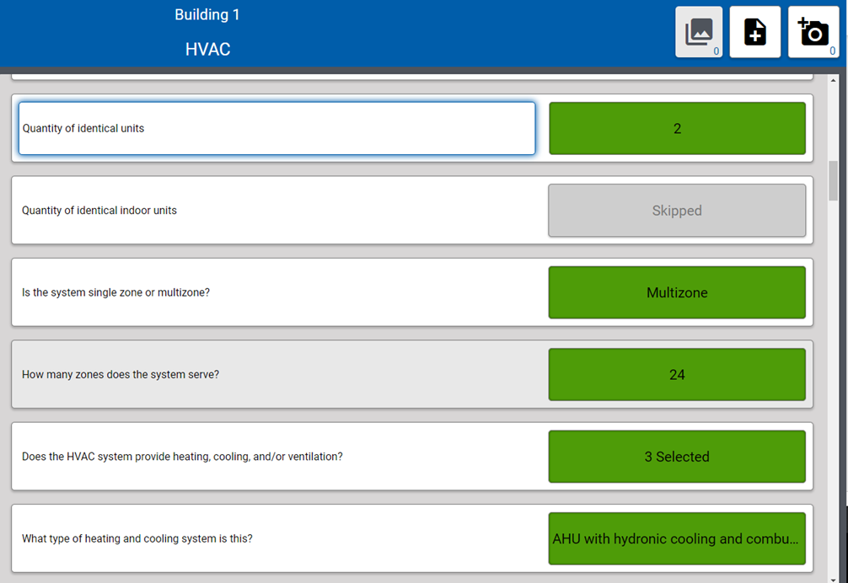
CBSA 2019 Methods: Data Collection
Tablet-Based Data Collection
Tool Linked Photos Directly to Data Entries
Approx. 550 Data Fields
Field Assessors Had to Prioritize Based on Time Available On-Site

Slide 17
CBSA 2019 Methods: Within-Site Sampling
Three Levels Possible Within-Site
  Building Sampling
  Business Sampling
  Room Sampling
Conditional on Approval from Site Contacts
Frequent Constraints from Site Contacts and Tenants

Slide 18
CBSA 2019 Methods: Case Weights
Determined as Function of Inclusion Probability
Logistic Regression Variables
  Stage 1 census block selection probability
  Stage 2 site floor area as fraction of total strata floor area
  Stage 2 recruitment eligibility rates
Trimmed Weights for Sites with Weighted Floor or Room Area Greater than 10% of Total
Calibrated Weights so Resulting Floor Area Equal to Total in Stage 1 Sample Frame within Each Type

Slide 19
CBSA 2019 Methods: Data Analysis
Equipment and Capacities Analyzed at Building Level
Applied Within-Site Sampling Weights
Lighting Power Density
Energy Use Intensities
Applied Case Weights to Calculate Region-Level Results

Slide 20
CBSA 2019 Methods: Database and Tables
Final data stored as SQL relational database
Extensive dataset – 96 tables with 1,241 unique columns
62 analysis tables in public Excel workbook
Public flat file tables
  Building summary
  HVAC summary
  Lighting summary

Slide 21
Key Findings

Slide 22
Final Assessment Results
Building Type | Sample Targets | Sites Assessed | Buildings Assessed
Assembly | 56 | 60 | 72
Grocery | 68 | 59 | 60
Hospital | 45 | 43 | 53
Lodging | 71 | 66 | 83
Mixed Commercial | 83 | 99 | 73
Office | 116 | 108 | 153
Other | 21 | 13 | 24
Residential Care | 38 | 40 | 51
Restaurant | 51 | 46 | 53
Retail / Service | 89 | 105 | 133
School | 45 | 44 | 68
Warehouse | 83 | 66 | 109
Total | 766 | 749 | 932

Slide 23
Building Characteristics
Total Floor Space
  3,424 million square feet
  6% increase over 2014
  Variance in building type floor area from 2014
  Updated type definitions
  Added mixed commercial
  Buildings reclassified based on assessments

Slide 24
Building Types Updated Based on Site Assessments
 | Assembly | Grocery | Hospital | Lodging | Mixed Commercial | Office | Other | Residential Care | Restaurant | Retail / Service | School | Warehouse
Assembly | 47 |  |  | 1 | 5 | 3 |  |  |  | 1 | 1
Grocery |  | 56 |  |  | 4 |  |  |  | 1 | 8
Hospital |  |  | 41 |  |  | 2 |  | 1
Lodging |  |  |  | 62 | 1 |  |  |  |  | 1
Mixed Commercial | 6 | 3 | 1 | 2 | 39 | 12 |  | 1 | 3 | 8 | 1 | 1
Office | 4 |  | 1 | 1 | 12 | 82 | 2 | 1 |  | 9 |  | 3
Other | 1 |  |  |  | 7 | 6 | 6
Residential Care | 2 |  |  |  |  |  |  | 37
Restaurant |  |  |  |  | 6 |  |  |  | 42 | 3
Retail/Service |  |  |  |  | 11 | 1 | 1 |  |  | 67 |  | 3
School |  |  |  |  |  | 1 | 1 |  |  |  | 42 | 1
Warehouse |  |  |  |  | 14 | 1 | 3 |  |  | 8 |  | 58

Slide 25
Building Characteristics
Regional Floor Space by Building Size
  Majority of buildings in range of 5,000 to 50,000 ft²
  2019 found more floor area in smallest buildings
  Variance may result from 2014 using sites rather than buildings for analysis

Slide 26
Building Characteristics
Building Vintage
  2019 study better aligned floor area with construction era
  2014 oversampled most recent construction decade

Slide 27
Building Characteristics
Portion of Regional Floor Area by Electric Utility Ownership
  Nearly 2/3 of buildings in investor-owned utility service territory

Slide 28
Space Heating and Cooling
Heating Fuel
  80% Natural Gas
  19% Electricity
New construction showed even split of heating fuels
  18 buildings with electric
  18 buildings with gas

Slide 29
Space Heating and Cooling
Heated Floor Area by Building Type and Fuel
  Most rely almost entirely on gas

Slide 30
Space Heating and Cooling
Primary Heating System
  Furnaces dominate space heating equipment
  Hospitals and schools have distributed systems that rely on boilers
Notes:
The primary HVAC system is designated as the system representing the largest fraction of total reported HVAC capacity. Boilers, chillers, and water source heat pumps are considered primary systems over packaged systems if both types of systems exist in the building.

Slide 31
Space Heating and Cooling
Primary Cooling System
  Most buildings rely on DX for cooling
  Hospitals and schools have distributed systems that rely on chillers
Notes:
The primary HVAC system is designated as the system representing the largest fraction of total reported HVAC capacity. Boilers, chillers, and water source heat pumps are considered primary systems over packaged systems if both types of systems exist in the building.

Slide 32
Water Heating
Water Heating Fuel
  Natural gas water heating most common

Slide 33
Water Heating
Gas Water Heating System
  DHW tanks most frequent gas heating equipment
  Tankless increased from 5% to 19% since 2014

Slide 34
Water Heating
Electric Water Heating System
  25% of commercial water heating capacity is electric
  Almost no commercial penetration from heat pump water heaters
Notes:
Tankless water heating increased from 5% to 19% from 2014 to 2019

Slide 35
Lighting
Indoor Lighting Wattage
  LED power increased from 20 MW to 419 MW
  All other less-efficient lighting declined
  T12s declined only slightly

Slide 36
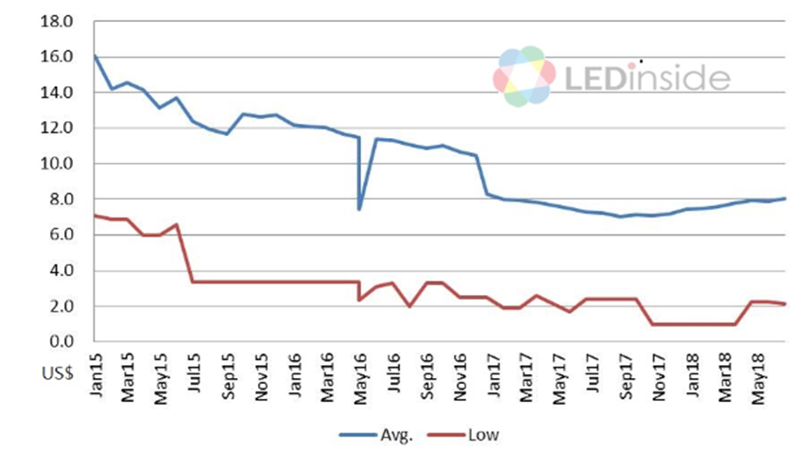
Lighting
Trends show lower LED costs and rising distribution volume
60W Equivalent Lamp Retail Price (2015-2018)
Regional 4-foot Lamp Distribution (2015-2019)
Source: LEDinside: https://www.ledinside.com/news/2018/8/global_led_lighting_products_price_trend
Source: NEEA Lighting Distribution Data

Slide 37
Lighting
Lighting Power Density
  LPD declined across all building types

Slide 38
Key Findings: Lighting
CBSA LPD vs. State Codes
  Current LPDs below code across most building types (green cells)
  Data shows office buildings have same or higher lighting LPD than code (white and orange cells)
  Washington code most stringent
Building Type | Idaho | Montana | Oregon | Washington
Assembly
Grocery
Hospital
Lodging
Office
Restaurant
Retail/Service
School
Warehouse

Slide 39
Lighting
Lighting Controls
  Manual controls still dominate
  Occupancy sensors now control 13% of lighting power
  Daylight harvesting controls less than 1% of lighting power

Slide 40
Energy Use Intensities
Combined Fuel EUI
  Decreased from 2014 for most building types
  Provides context with heating fuel changes from 2014
  Hospital EUI now aligns better with 2012 CBECS

Slide 41
Energy Use Intensities
Electric EUI
  Decreased from 2014 for almost all building types
  Lower LPD reduced electric EUIs
  Hospital EUI now aligns better with 2012 CBECS

Slide 42
Energy Use Intensities
Monthly Electric EUI
  More than half of building types show electric peak in summer
  Remainder have winter peak

Slide 43
Energy Use Intensities
Natural Gas EUI
  Little change since 2014 for most
  Hospital now aligns better with CBECS
  2019 data found higher restaurant natural gas EUIs in sample

Slide 44
Conclusions

Slide 45
Conclusions
Virtual Catalog Provides Option for More Robust Sample Frames
  Google Places data helps fill in gaps in tax assessor data (e.g., government buildings, schools)
  More recently updated data
  Challenges with multiple listings at the same location
  Does not filter out home-based businesses
  Manual review of data can be budget-intensive

Slide 46
Conclusions
New Commercial Buildings Rely More on Electric Heating
  Overall sample found 80% of regional floor area with gas heating
  36 buildings in sample constructed since 2014
  Split in half on space heating fuel
  Total floor area for electric heated buildings was 20% higher than gas heated buildings

Slide 47
Conclusions
LED Adoption Increased Dramatically
  Energy efficiency programs and education pushed LEDs
  LED prices also dropped dramatically
  LED portion of regional lighting power increased from 1% to 17%
  Primarily displacing HIDs, incandescent bulbs, and CFLs
  Overall decrease in regional lighting power from 2,944 MW to 2,531 MW (-14%)

Slide 48
Conclusions
Significant Regional Energy Efficiency Opportunities Remain
  Linear Fluorescent Lamps to LEDs
    Linear fluorescents still represent 1,737 MW (69% of lighting power)
  Lighting Controls
    Two-thirds of lighting power controlled by manual on/off switches
    Occupancy sensors only control 13%, daylight harvesting < 1%
  Conventional Tank Water Heating Replacement
    DHW tanks represent most of water heating capacity
    Tankless tripled to 19% of gas water heating capacity
    Heat pump water heaters are small portion of overall capacity

Slide 49
Conclusions
LEDs Reduced Indoor Lighting Power Density
  Overall average LPD declined by 25% from 2014
  Almost all building types show reduction of 19% to 37%
  Review of lighting power data shows reduction driven mostly by LED retrofits

Slide 50
Conclusions
LEDs Reduced Electric Energy Use Intensity
  Regional electric EUI declined by 17% from 2014
  Most building types reduced electric EUI by 20% to 40%
  Decrease in LPD through LEDs drove much of reduction
  2019 CBSA distribution of heating fuels contributed to lower electric EUIs
  Assume regional energy efficiency programs also contributed to EUI reduction

Slide 51
Questions

Slide 52
Send out presentation and address unanswered questions (if any) 5/12
Final adjustments to report and database – 5/15
Report and Database Available on NEEA Website by 5/22
NEXT STEPS

Slide 53
Aaron James
Market Intelligence Analyst, NEEA
503.688.5465 AJames@NEEA.org
Jeff Cropp
Principal, Cadmus
503.467.7120 Jeff.Cropp@cadmusgroup.com

